Slide 2
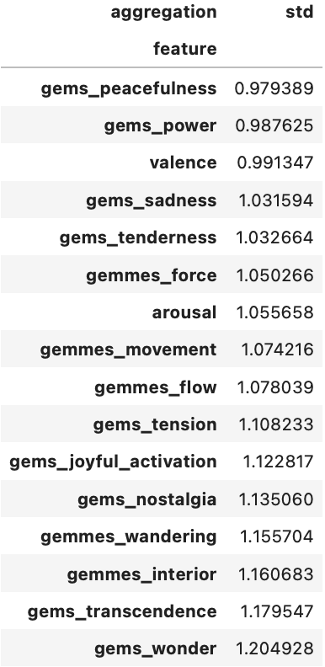
How consistent are the emotion annotations?
Do different annotators agree in their ratings of the same excerpt?
It depends!
low std → high consistency
Standard deviation is a good indicator for annotation consistency.
high std → low consistency
Conclusion: Some emotions are more objective than others.

Slide 3
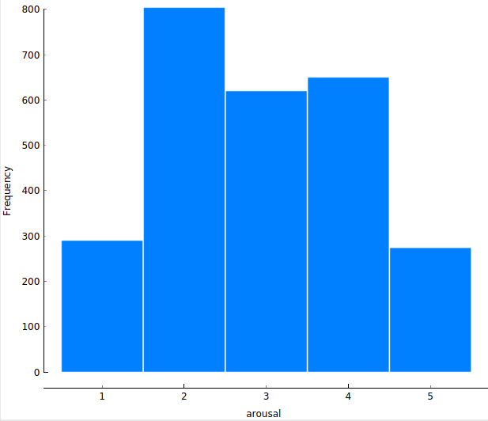
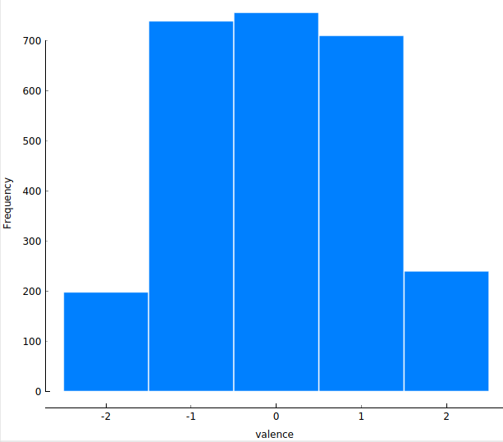
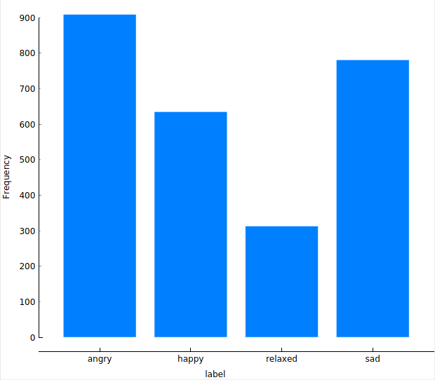
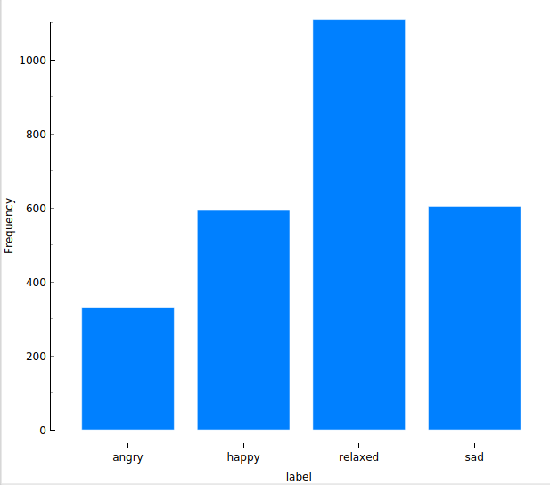
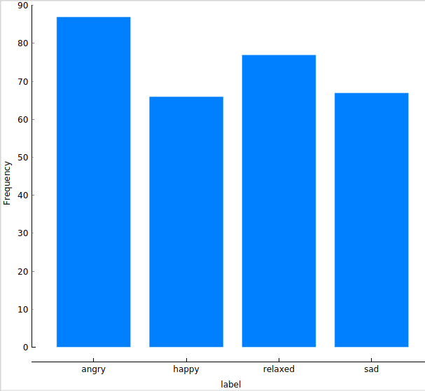
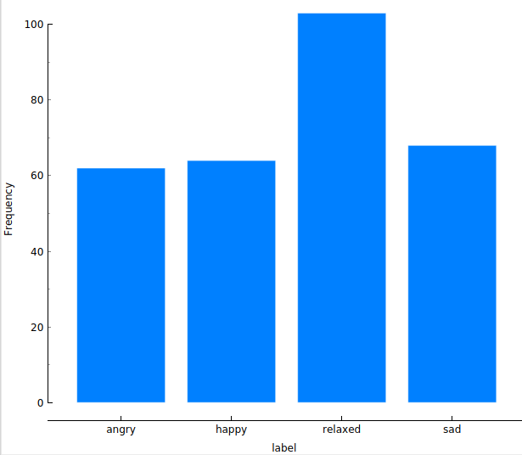
Data Exploration / derive quadrant-based labels
Distribution of arousal and valence in raw annotation data:
Looks a bit of Gaussian normal distribution.
So it is important how the middle values are classified.
Overall means: arousal: 2.93, valence: 0.02.
Therefore we have decided
on the following classification:
Angry: arousal >= 3, valence <= 0
Happy: arousal >=3, valence > 0 Sad: arousal < 3, valence <= 0
Relaxed: arousal < 3, valence > 0
A slightly different classification results
in a total different distribution:
Angry: arousal > 3, valence = 0
Happy: arousal > 3, valence >= 0 Sad: arousal <= 3, valence = 0
Relaxed: arousal <= 3, valence >= 0
To label the aggregated data over all annotators, there are many possibilities. We can take the median of arousal and valence
or we can do a majority vote over the raw labels. But in both cases, the result is very dependent on the assignment of the
values 3 and 0 for arousal and valence respectively. So we decided to take the mean of arousal and valence over all annotators
and thus do not have the clustering at 3 and 0 respectively. The values 3 and 0 were assinged in such a way that the distribution
is as balanced as possible. Outliers are not a problem with the mean, as the annotations must be within a fixed range.
With the mean-value not in the „=“
Angry: arousal >= 3, valence <= 0
Happy: arousal >=3, valence > 0 Sad: arousal < 3, valence <= 0
Relaxed: arousal < 3, valence > 0
Not so balanced, if the mean-value
is in the range with „=“:
Angry: arousal > 3, valence = 0
Happy: arousal > 3, valence >= 0 Sad: arousal <= 3, valence = 0
Relaxed: arousal <= 3, valence >= 0
Conclusion: First we aggregate the raw data and derive the labels from the mean of arousal and valence.

Slide 4
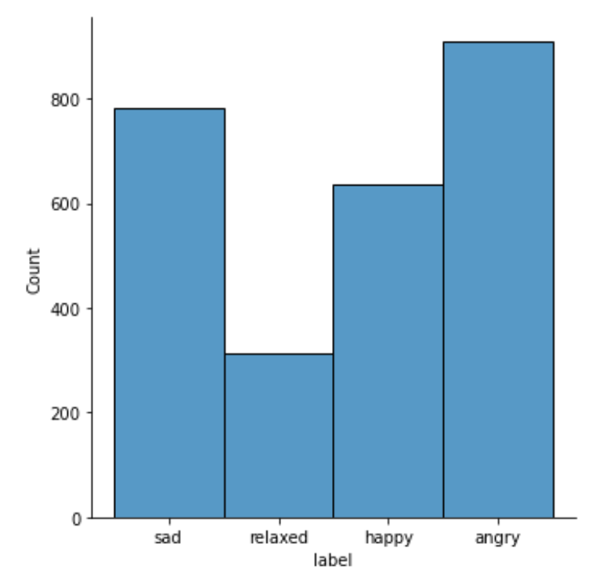
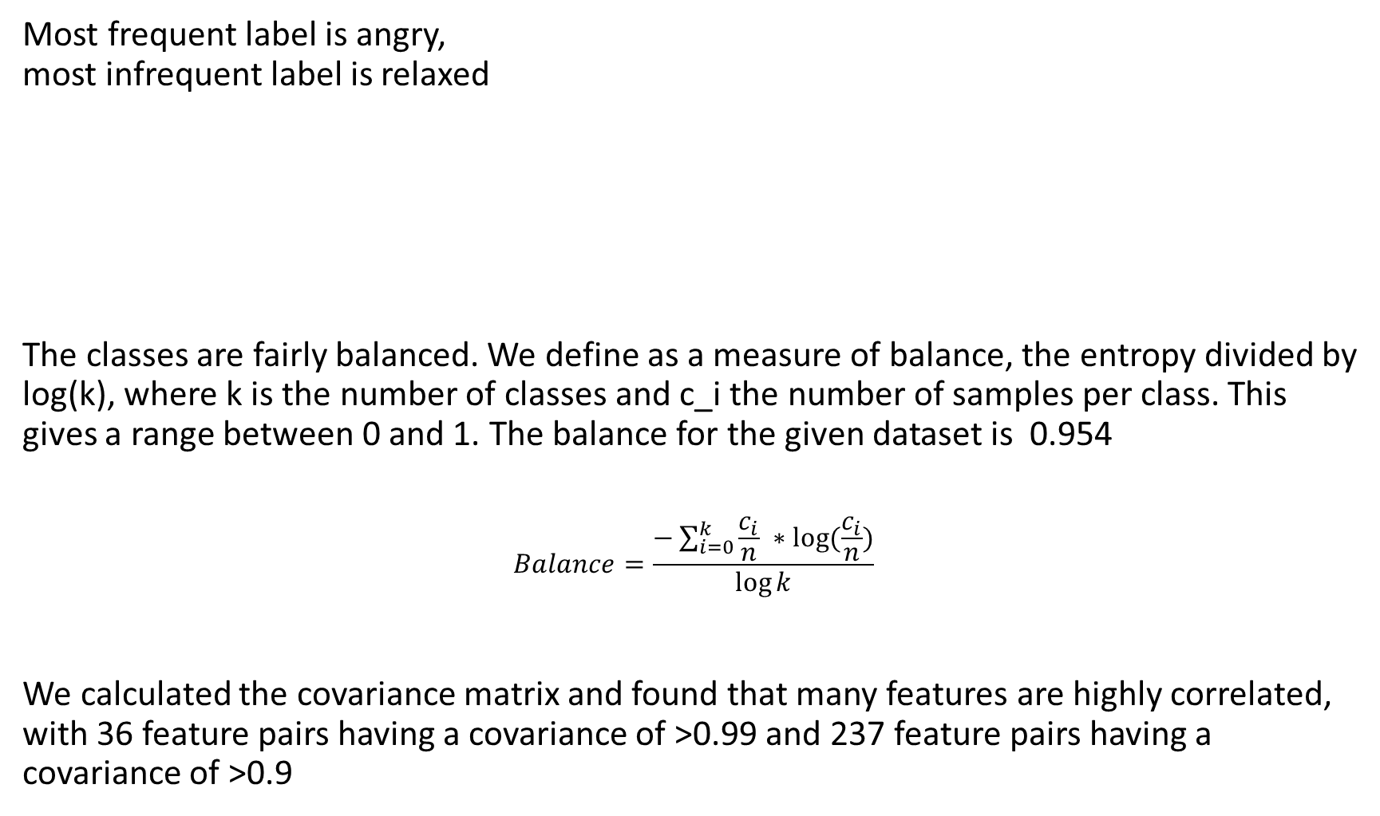
Most frequent label is angry, most infrequent label is relaxed
The classes are fairly balanced. We define as a measure of balance, the entropy divided by log(k), where k is the number of classes and c_i the number of samples per class. This gives a range between 0 and 1. The balance for the given dataset is 0.954
$$Balance=\frac{−\sum_{i=0}^{k}{\frac{c_{i}}{n}} ∗log(\frac{c_{i}}{n})}{\log{k}}$$
We calculated the covariance matrix and found that many features are highly correlated, with 36 feature pairs having a covariance of >0.99 and 237 feature pairs having a covariance of >0.9

Slide 5
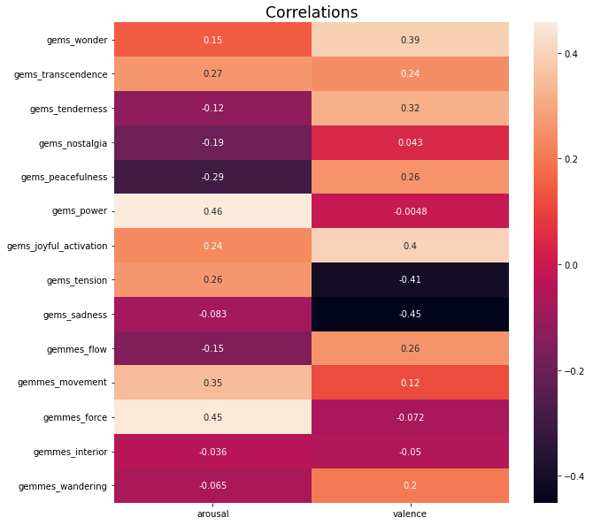
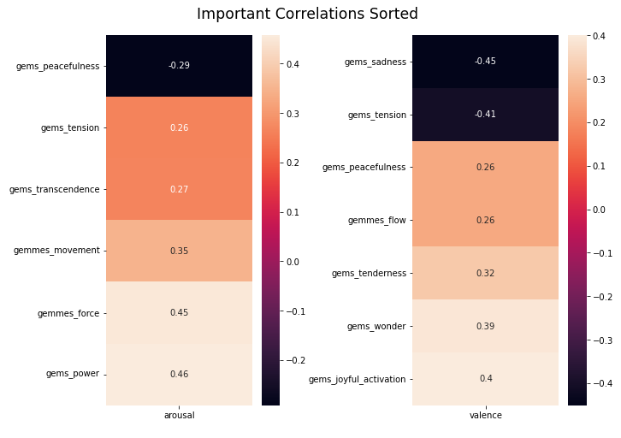
How are GEMS9 and GEMMES related to arousal and valence?
Some correlations appear between GEMS9/GEMMES and arousal/valence but no strong relationships
Different features have a more meaningful impact on arousal and valence
GEMMES features tend to have a stronger positive/negative correlation than GEMS9

Slide 6
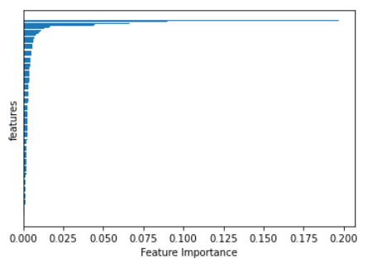
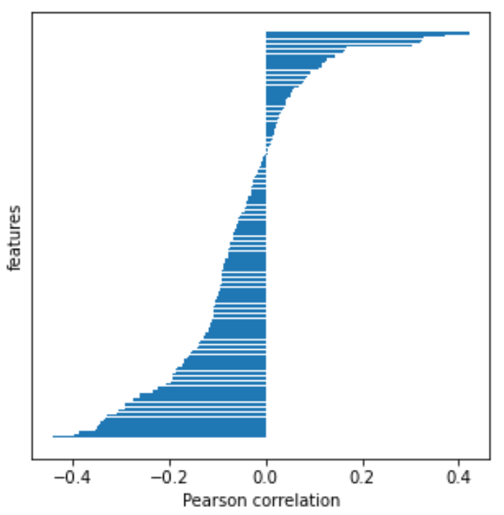
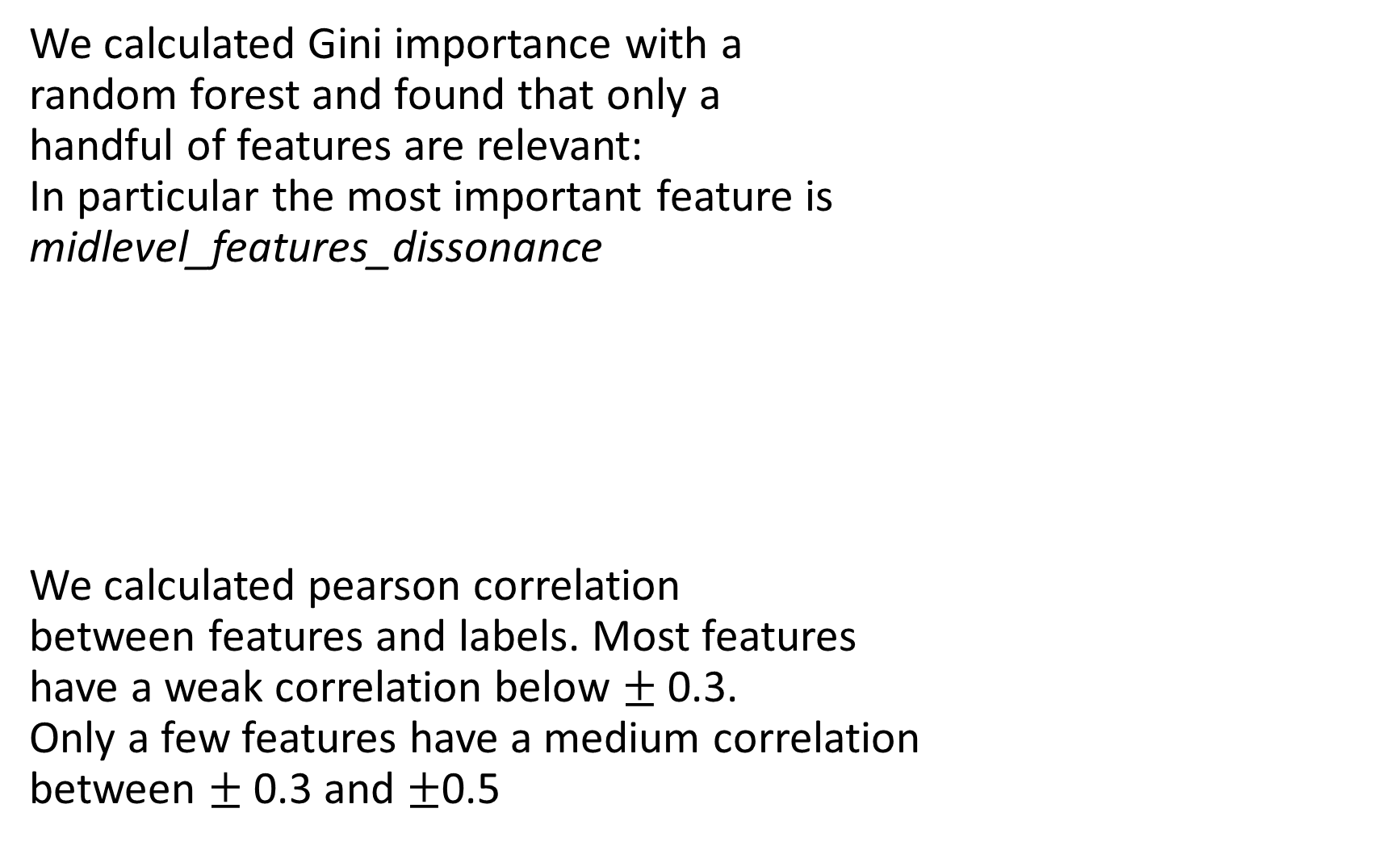
We calculated Gini importance with a random forest and found that only a handful of features are relevant: In particular the most important feature is midlevel_features_dissonance
We calculated pearson correlation between features and labels. Most features have a weak correlation below $±$ 0.3. Only a few features have a medium correlation between $±$0.3 and $±$0.5

Slide 7
Conclusion
After exploring the data we conclude the following:
Q1: In order to determine how different the annotations are, we used standard dev. to measure difference in annotations, with an average of 1.084 with a range between 0.979 – 1.205
Q2: Its essential how the middle value of arousal and valence is assigned to the class. We used the mean to aggregate the annotations.
Q3: We found that the classes are rather balanced, with a balance measure of 0.95. Features are on average slightly positively skewed. We found 37 feature pairs that have a correlation of >0.99 and are thus redundant
Q4: There appear some relations but no strong correlations, with highest corr. Being 0.46 and -0.45
Q5: We found that only a handful of features are by far the most important, with the most important being midlevel_features_dissonance
Conclusion for next training phase: One can ignore many of the low level features. Maybe the general rating preference for individual annotators should be considered.

